Slide 1


Monetary Policy Committee
Monetary Policy Report August 2021
Current economic conditions

Slide 2
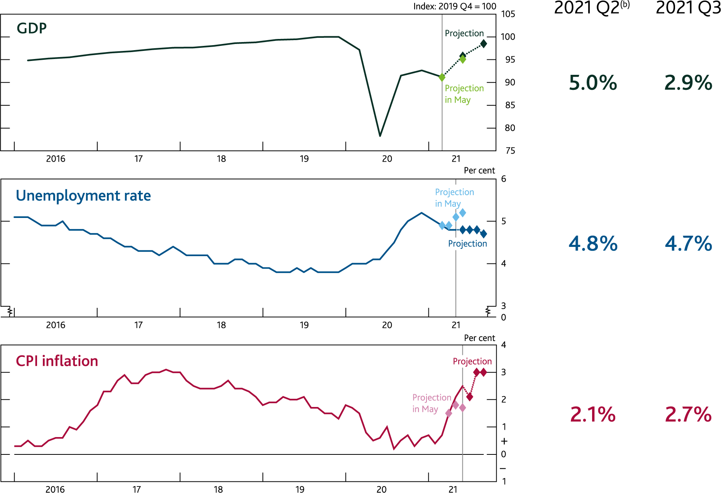
Chart 2.1: GDP is expected to increase in 2021 Q3; unemployment is expected to fall a little; and inflation is expected to rise further above the 2% target
Near-term projections^{(a)}
Sources: ONS and Bank calculations.
(a) The lighter diamonds show Bank staff’s projections at the time of the May 2021 Monetary Policy Report. The darker diamonds show Bank staff’s current projections. Projections for GDP are quarterly and show Q2 and Q3 (May projections show Q1 and Q2). Projections for unemployment and CPI are monthly and show June to September and July to September respectively (May projections show March to June and April to June respectively).
(b) GDP and unemployment projections are based on official data to May. CPI inflation figure is an outturn.

Slide 3
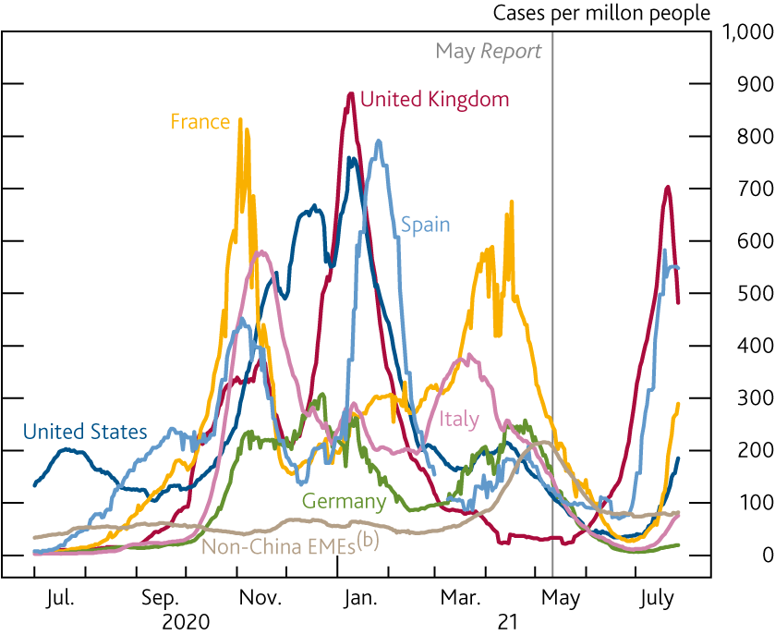
Chart 2.2: Covid cases are rising in some countries, driven by the Delta variant
Daily new confirmed Covid-19 cases^{(a)}
Sources: COVID-19 Data Repository by the Centre for Systems Science and Engineering at Johns Hopkins University, Our World in Data and Bank calculations.
(a) Seven-day moving averages. Data are shown to 27 July and are not seasonally adjusted.
(b) Series includes Brazil, India, Indonesia, Mexico, Russia, South Africa and Turkey.

Slide 4
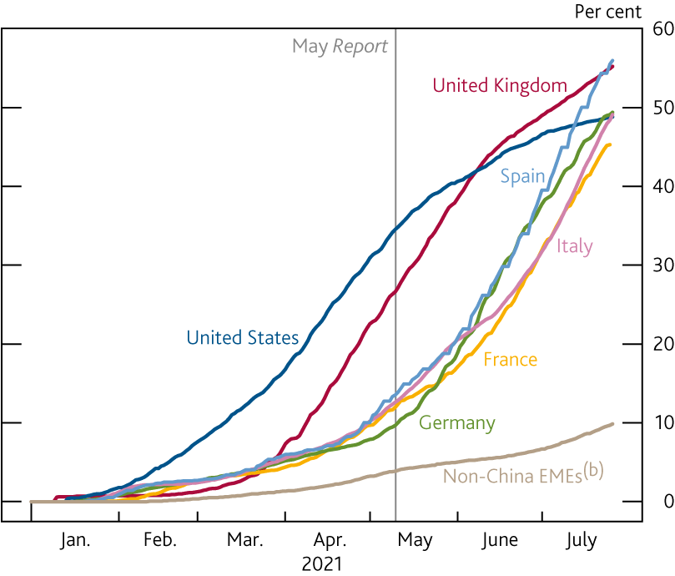
Chart 2.3: An increasing share of the population in advanced economies is fully vaccinated
Percentage of population fully vaccinated^{(a)}
Sources: Our World in Data and Bank calculations.
(a) Share of the total population that have received all doses prescribed by the vaccination protocol. Data are shown to 26 July.
(b) Series includes Brazil, India, Indonesia, Mexico, Russia, South Africa and Turkey.

Slide 5
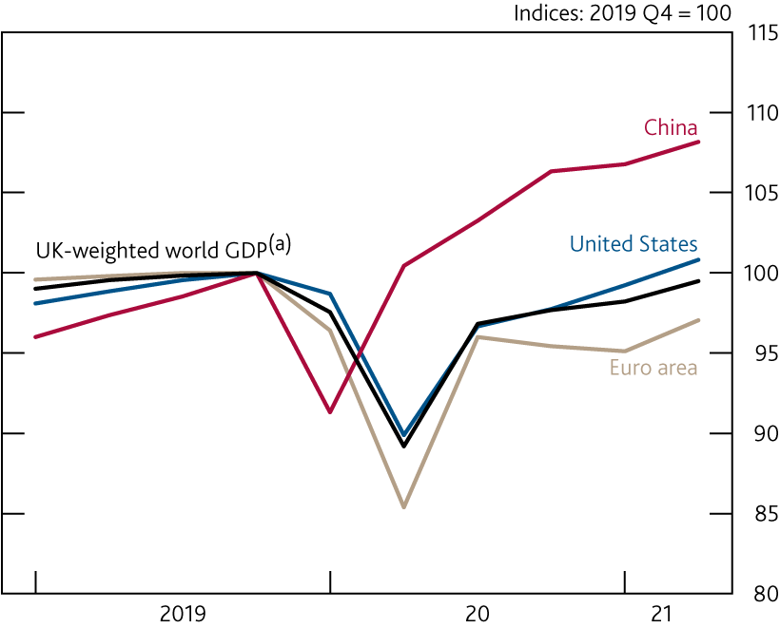
Chart 2.4: The global economy has continued to recover
GDP in selected countries and regions
Sources: Refintiv Eikon from LSEG, IMF World Economic Outlook (WEO), National Bureau of Statistics of China, OECD, ONS and Bank calculations.
(a) See footnote (c) of Table 1.B for definition. Figure for 2021 Q2 is a Bank staff projection.

Slide 6
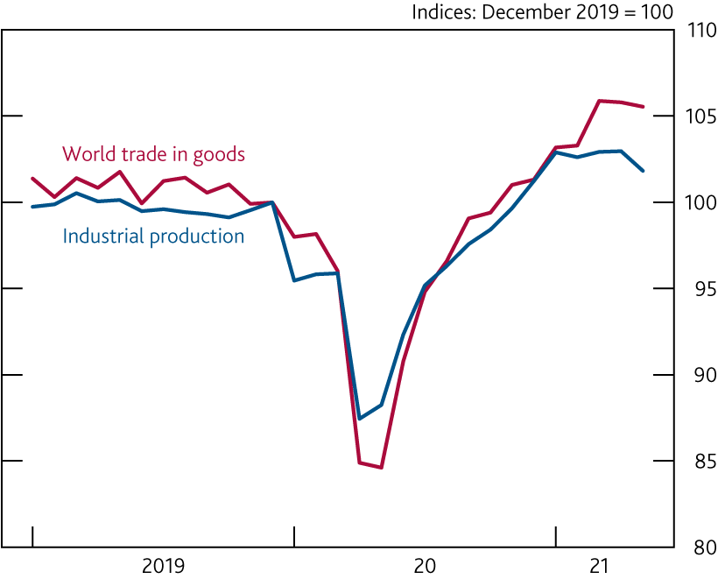
Chart 2.5: Global goods trade and industrial production are above their pre-Covid levels
World trade in goods and industrial production^{(a)}
Sources: CPB Netherlands Bureau for Economic Policy Analysis and Bank calculations.
(a) Latest data points are for May 2021.

Slide 7
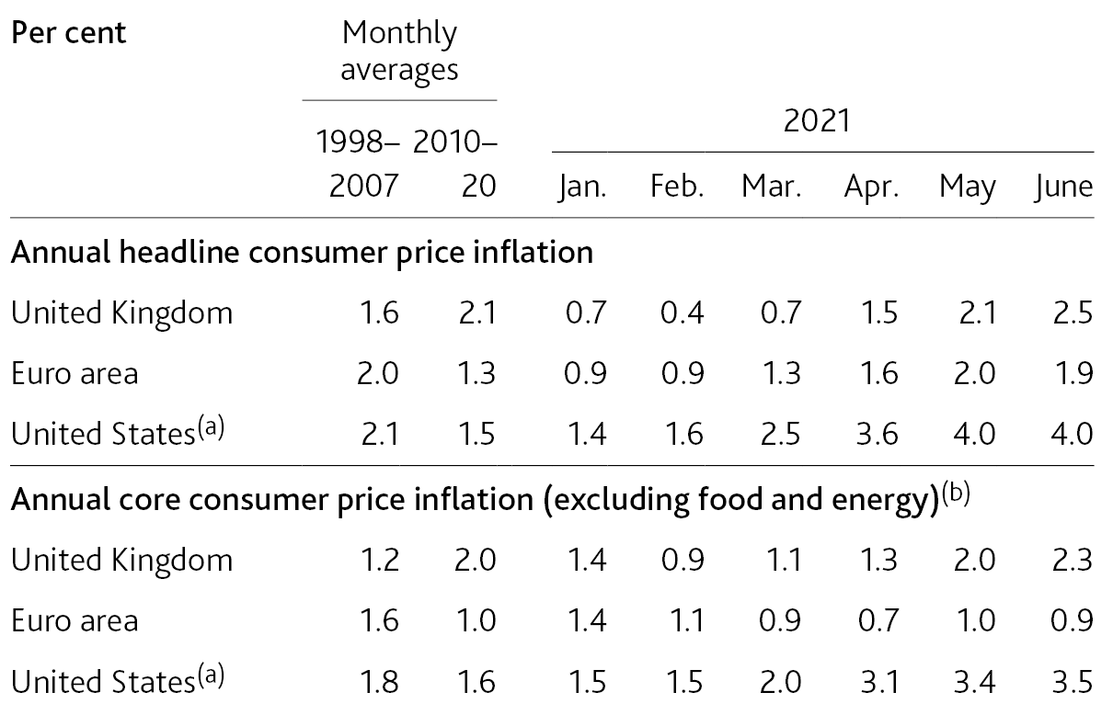
Table 2.A: Inflation rates have picked up around the developed world
Inflation in the UK, euro area and US
(a) Personal consumption expenditure price index inflation.
(b) For the euro area and the UK, excludes energy, food, alcoholic beverages and tobacco. For the US, excludes food and energy.

Slide 8
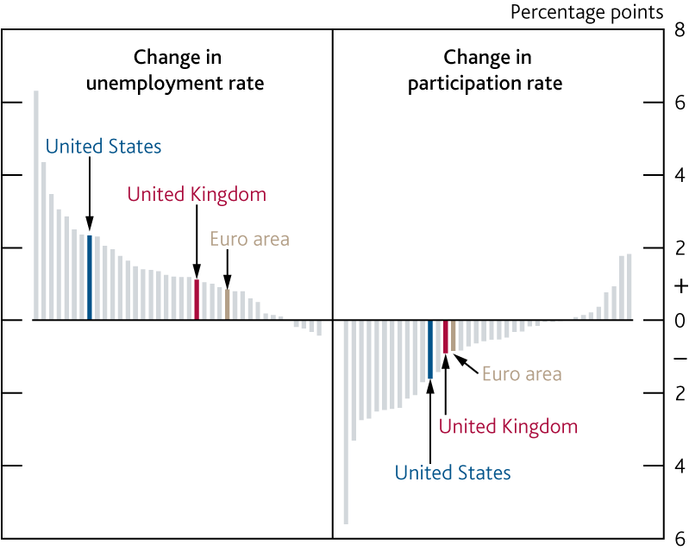
Chart 2.6: Unemployment remains higher and participation lower than before the pandemic in many countries
Changes in unemployment and participation rates since 2019 Q4^{(a)}
Sources: OECD and Bank calculations.
(a) Changes between 2019 Q4 and the latest quarterly figure on OECD.Stat; for most countries the latest figure is for 2021 Q1. All OECD member countries, and the euro-area average, are shown, except Germany. Age 15+ unemployment/participation. For the UK, Iceland, Norway, Spain and US the lower age limit is 16.

Slide 9
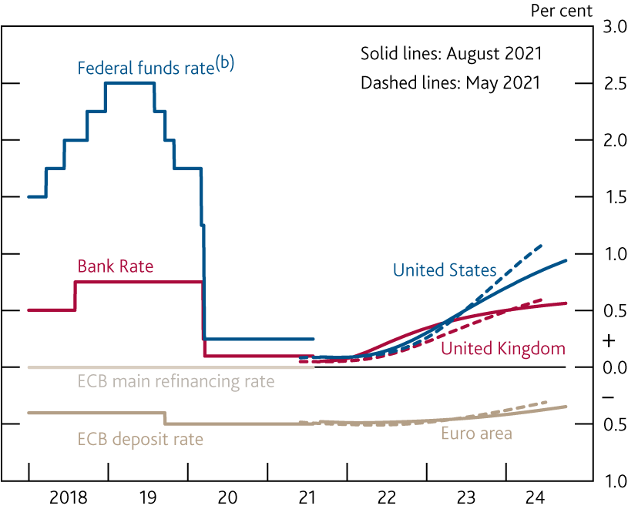
Chart 2.7: Market expectations for policy rates are broadly unchanged since May
International forward interest rate^{(a)}
Sources: Bloomberg Finance L.P. and Bank calculations.
(a) All data as of 28 July 2021. The August and May curves are estimated using instantaneous forward overnight index swap rates in the 15 working days to 28 July and 27 April 2021 respectively.
(b) Upper bound of the target range.

Slide 10
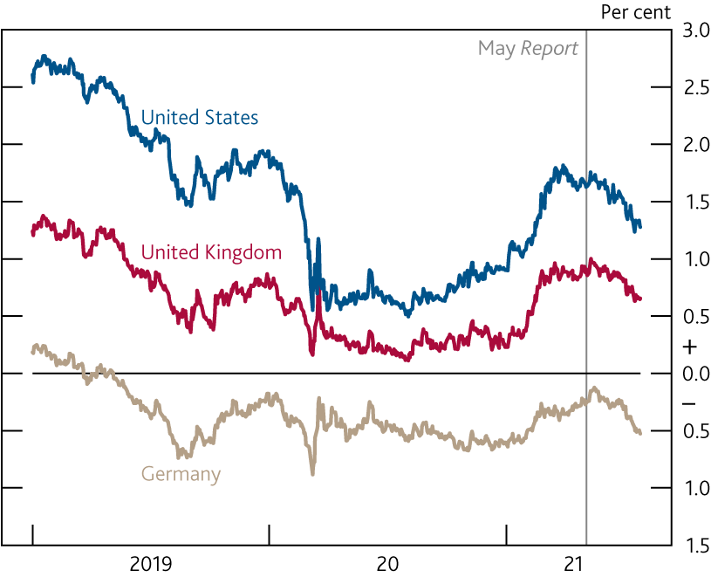
Chart 2.8: Longer-term interest rates have fallen after rising earlier in the year
Ten-year nominal interest rates
Sources: Bloomberg Finance L.P., Tradeweb and Bank calculations.

Slide 11
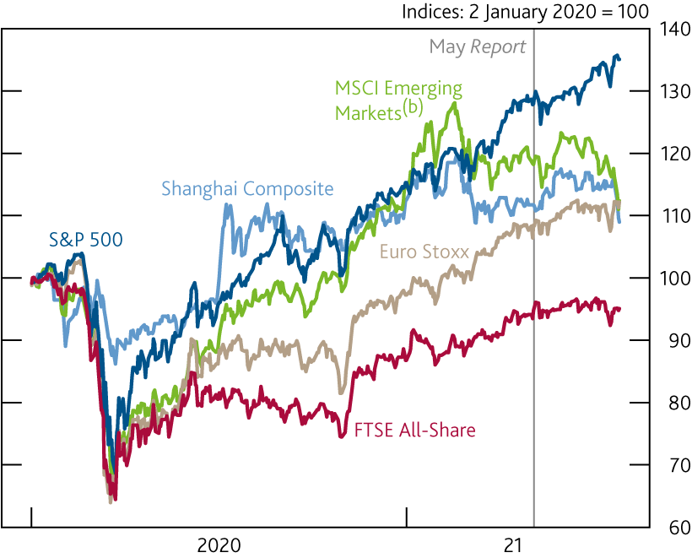
Chart 2.9: Equity prices have risen over the past year
International equity prices^{(a)}
Sources: MSCI, Refintiv Eikon from LSEG and Bank calculations.
(a) In local currency terms, except for MSCI Emerging Markets which is in US dollar terms.
(b) The MSCI Inc. disclaimer of liability, which applies to the data provided, is available from Monetary Policy Report – August 2021.

Slide 12
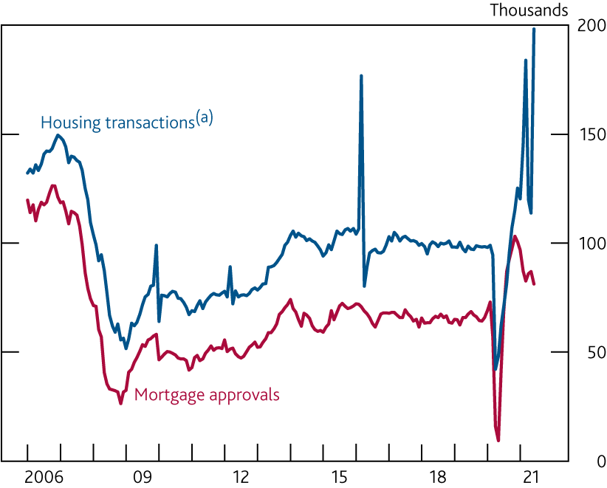
Chart 2.10: Demand for mortgages has remained elevated and transactions were very high in June
Mortgage approvals for house purchase and housing transactions
Sources: Bank of England, Her Majesty's Revenue and Customs (HMRC) and Bank calculations.
(a) Residential property transactions for values of £40,000 or above.

Slide 13
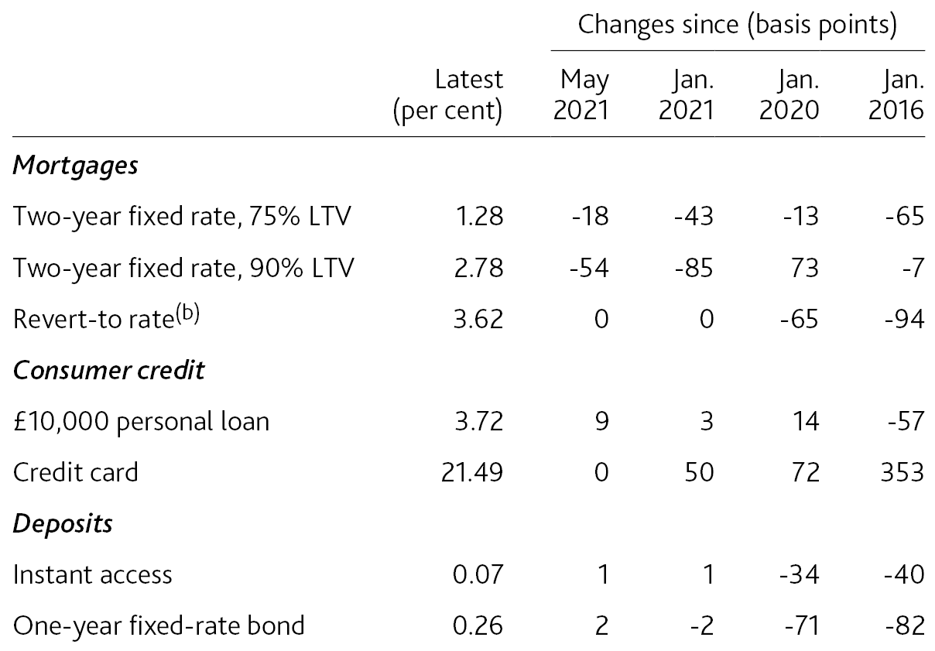
Table 2.B: New mortgage rates have fallen since the start of the year
Selected quoted household interest rates^{(a)}
(a) The Bank’s quoted rates series are weighted monthly average rates advertised by all UK banks and building societies with products meeting the specific criteria. In February 2019 the method used to calculate these data was changed. For more information, see ‘Introduction of new Quoted Rates data – Bankstats article’. Data are not seasonally adjusted. Latest data are flash estimates for July using data to 28 July and are subject to change until publication on 6 August.
(b) Previously known as standard variable rate (SVR).

Slide 14
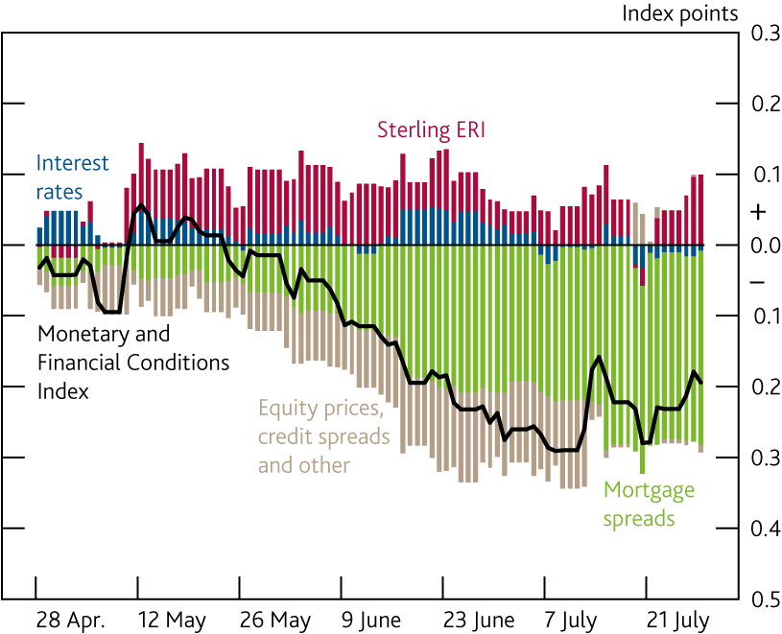
Chart 2.11: A summary measure suggests that financial conditions have loosened slightly since the May Report
Contributions to the change in the UK Monetary and Financial Conditions Index since the May 2021 Report^{(a)}
Sources: Bank of England, Bloomberg Finance L.P., ICE/BoAML, IMF WEO, Money Facts, Refinitiv Eikon & I/B/E/S, both from LSEG, Tradeweb and Bank calculations.
(a) The UK Monetary and Financial Conditions Index (MFCI) summarises information from the following series: short-term interest rates, the sterling ERI, corporate bond spreads, equity prices, and household and corporate bank lending spreads. The series weights are based on the historical association of each variable with UK GDP. The chart shows changes in the MFCI from the average level over the 15 working days to 27 April 2021. An increase in the MFCI signals tighter financial conditions and a decrease signals looser conditions. For more information, see ‘How do we monitor UK financial conditions?’.

Slide 15
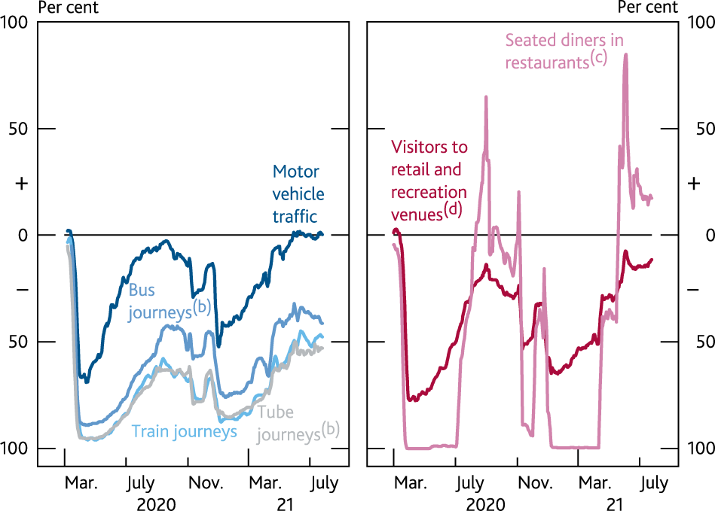
Chart 2.12: High-frequency indicators suggest that activity picked up as Covid restrictions eased
High-frequency indicators of economic activity^{(a)}
Sources: Department for Transport, Google Covid-19 Community Mobility Reports, OpenTable and Bank calculations.
(a) Seven-day moving averages to 26 July for transport data and 25 July for retail footfall and restaurant bookings. Data are not seasonally adjusted. All data are shown relative to normal levels.
(b) The number of tube journeys is based on Transport for London data and the number of bus journeys does not include London buses.
(c) Seated diners from online, phone and walk-in reservations.
(d) Numbers of visitors to places such as restaurants, cafes, shopping centres, theme parks, museums, libraries and cinemas.

Slide 16
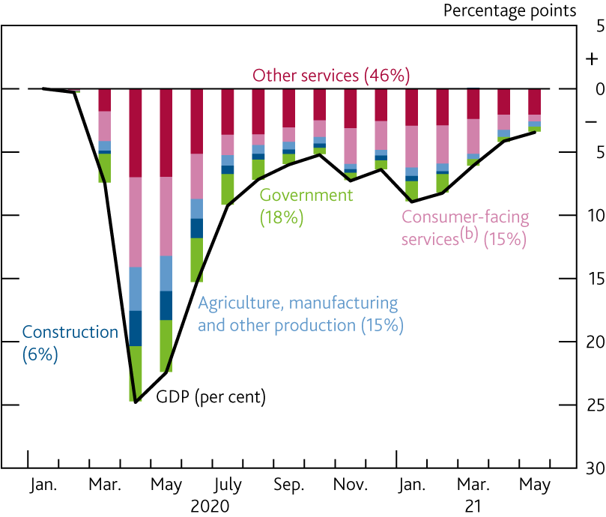
Chart 2.13: Consumer services are expected to have accounted for a large part of the recovery during Q2
Contributions to change in monthly GDP since January 2020^{(a)}
Sources: ONS and Bank calculations.
(a) Figures in parentheses are weights in gross value added in 2018. Weights and contributions may not sum to the total due to rounding.
(b) Includes accommodation and food services, arts, entertainment and recreation, and wholesale and retail.

Slide 17
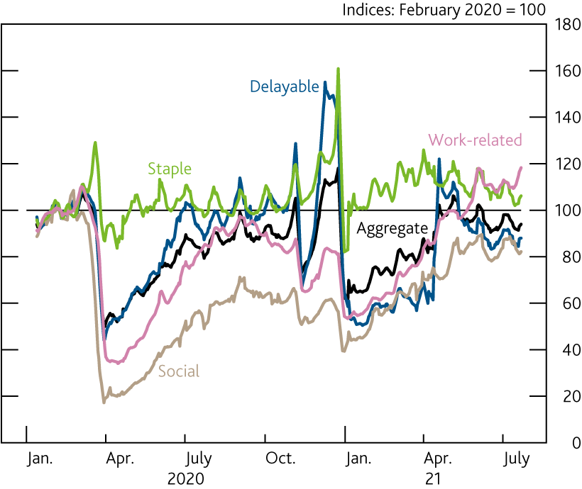
Chart 2.14: Aggregate card spending has recovered to around its levels last summer
UK spending on debit and credit cards by consumption category^{(a)}
Sources: Bank of England and ONS.
(a) Seven-day rolling averages. Data are nominal, not seasonally adjusted. Latest data point is for the seven days to 22 July 2021.

Slide 18
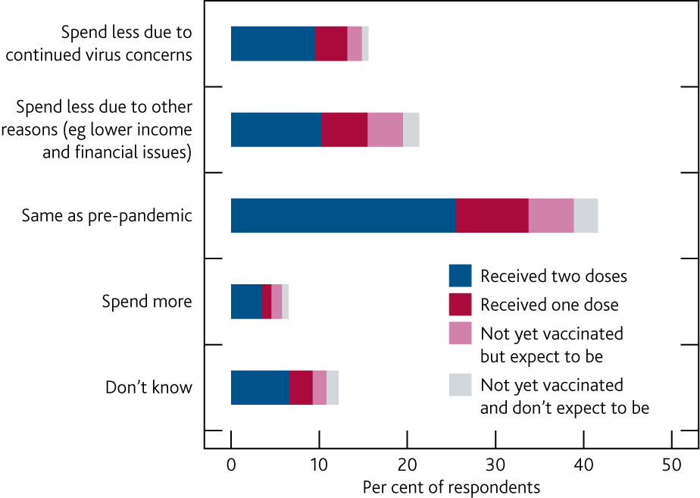
Chart 2.15: Some households remain cautious about future spending, even after receiving two vaccine doses
Household spending plans over the next three months compared with before the pandemic by vaccination status^{(a)}
Sources: NMG Consulting and Bank calculations.
(a) Question: ‘Now that many of the government restrictions are being relaxed how much do you think you will be spending over the next three months compared with before the pandemic?’. Responses from those who preferred not to state their vaccination status are not shown. This survey was conducted between 1–23 June 2021.

Slide 19
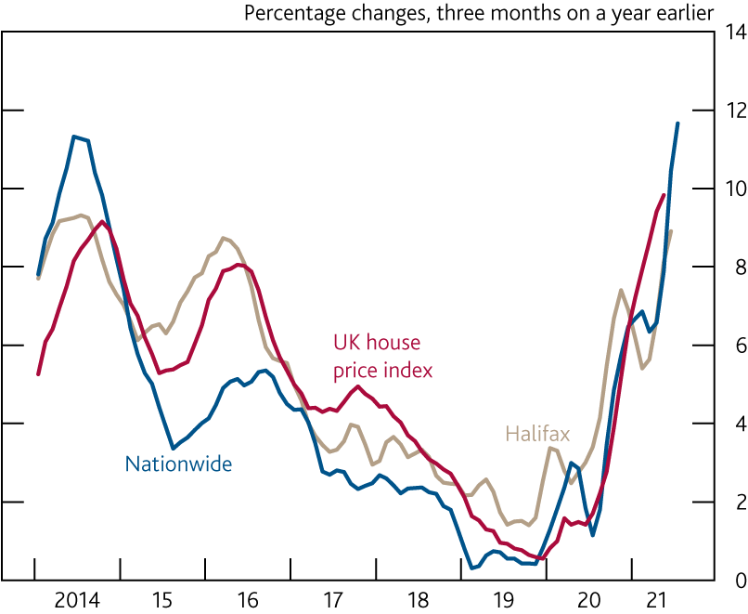
Chart 2.16: House prices have risen sharply since the middle of 2020
House prices^{(a)}
Sources: Halifax house price index by IHS Markit, HM Land Registry, Nationwide and Bank calculations.
(a) Latest data point is May 2021 for the UK house price index, June 2021 for Halifax and July 2021 for Nationwide.

Slide 20
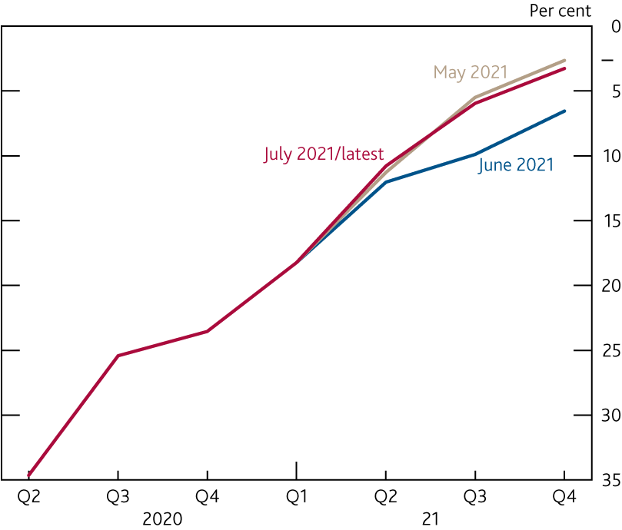
Chart 2.17: The DMP Survey suggests that the impact of Covid on investment became less negative in Q2
Impact of Covid on investment^{(a)}
Sources: DMP Survey and Bank calculations.
(a) Question: ‘Relative to what would have otherwise happened, what is your best estimate for the impact of the spread of coronavirus (Covid‑19) on the capital expenditure of your business in the following quarters?’. Months refer to survey waves. The July survey was conducted between 2–16 July 2021.

Slide 21
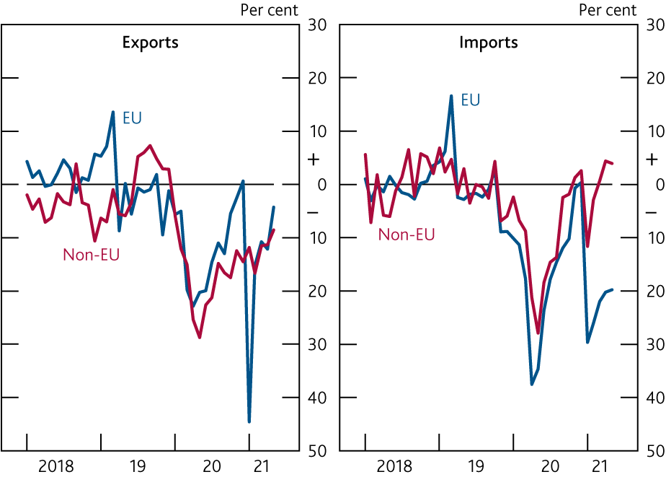
Chart 2.18: Goods exports to the EU recovered somewhat during Q2
Changes in UK trade in goods with EU and non-EU countries relative to 2019 averages^{(a)}
Sources: ONS and Bank calculations.
(a) All data exclude unspecified goods. Latest data points are for May 2021.

Slide 22
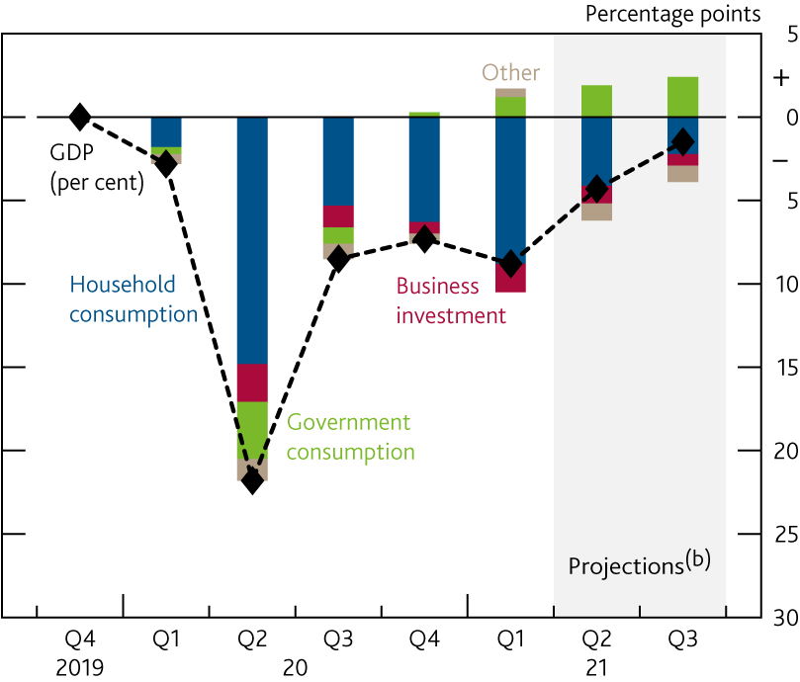
Chart 2.19: UK GDP is expected to grow by 2.9% in Q3
Contributions to change in quarterly GDP since 2019 Q4^{(a)}
Sources: ONS and Bank calculations.
(a) Household consumption data include non-profit institutions serving households.
(b) Bank staff projections.

Slide 23
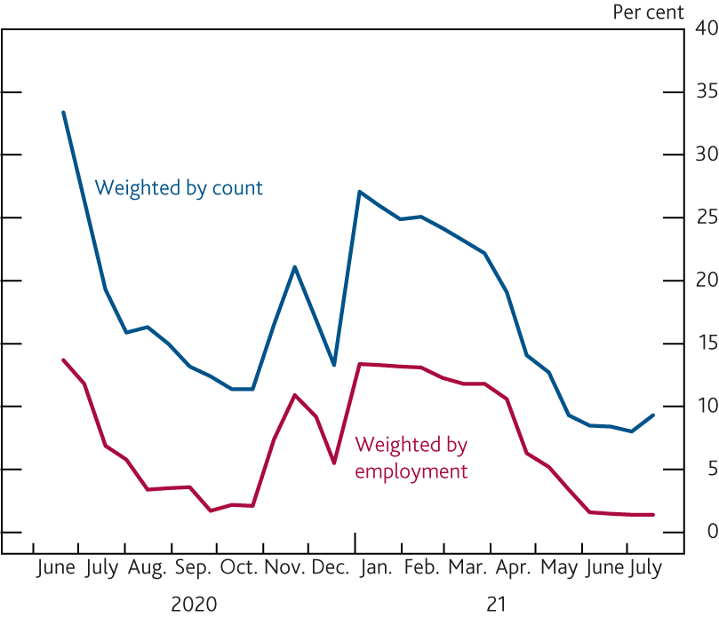
Chart 2.20: Many businesses have resumed trading since Q1
Proportion of businesses which have paused trading^{(a)}
Sources: ONS and Bank calculations.
(a) Final data points are from wave 35 of the Business Insights and Conditions Survey and cover the survey sample period of 12–25 July 2021.

Slide 24
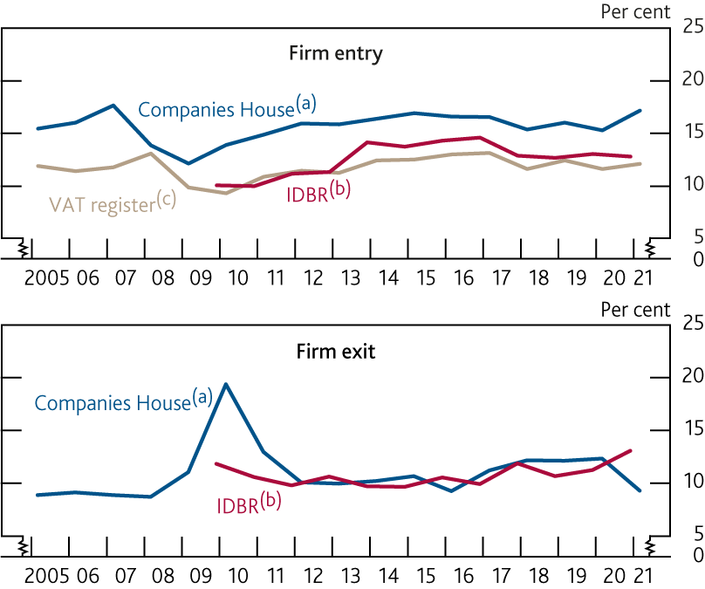
Chart 2.21: Firm entry has held up and firm exits have been limited considering the impact of Covid on activity
Measures of annual firm entry and exit rates in the UK
Sources: Companies House, HMRC, ONS and Bank calculations.
(a) Number of companies incorporated and dissolved as a share of the total Companies House register. Data are for financial years (April to March) to March 2021 and are for the United Kingdom from the 12 months to March 2010 onwards and for Great Britain previously.
(b) Births and deaths of enterprises as a share of active enterprises on the IDBR. Calendar year figures to 2020.
(c) New VAT registrations as a share of the live trader population. Data are for financial years to March 2021.

Slide 25
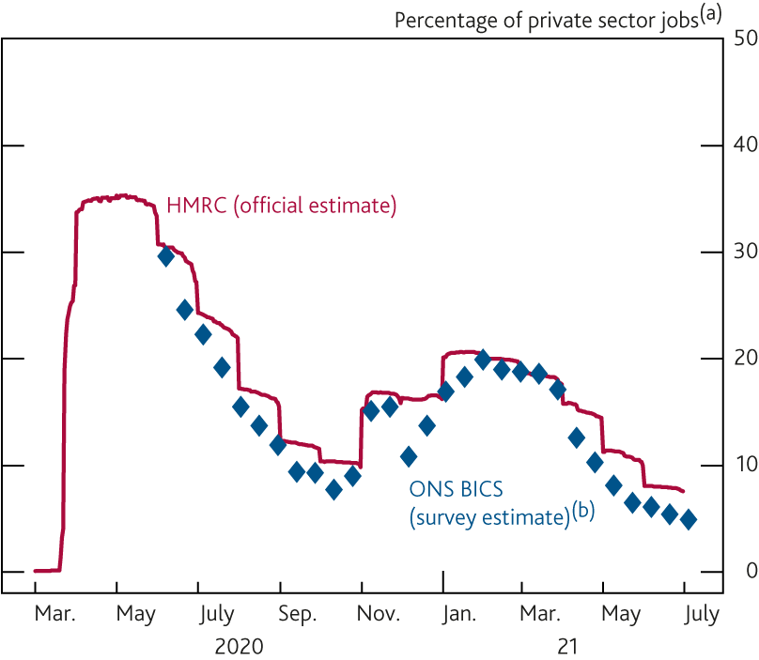
Chart 2.22: Use of the furlough scheme continues to decline
Furloughed jobs
Sources: HMRC, ONS and Bank calculations.
(a) Total employee jobs minus public sector employment.
(b) Business Insights and Conditions Survey. Final data point is from wave 35 and covers the survey reference period of 28 June–11 July 2021.

Slide 26
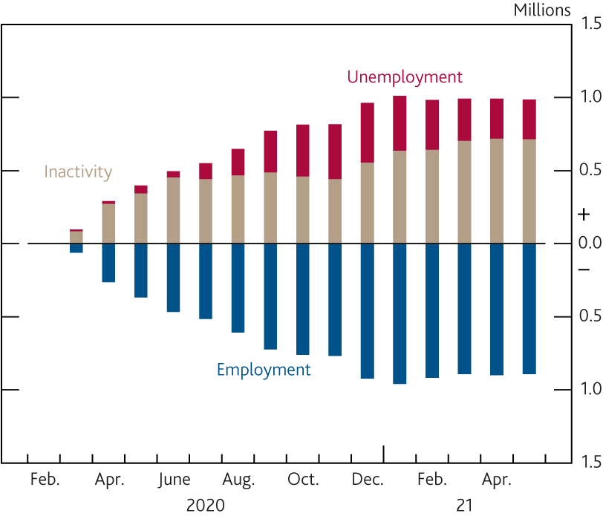
Chart 2.23: Numbers inactive in the labour market have continued to rise in 2021 so far
Changes in employment, unemployment and inactivity since the three months to February 2020^{(a)}
Sources: ONS and Bank calculations.
(a) Data from the Labour Force Survey and employment includes employees and self-employed. Changes do not sum to 0 as the population is estimated to have increased during the period.

Slide 27
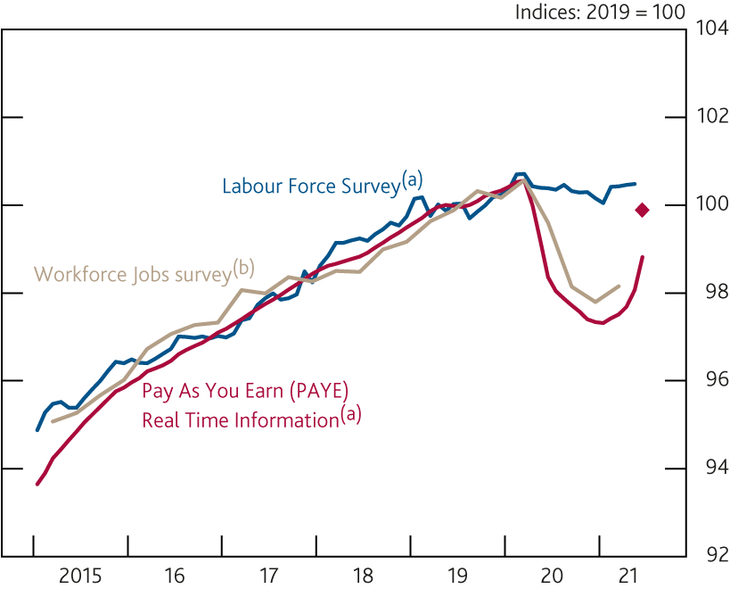
Chart 2.24: The number of employees has increased sharply according to payroll data
Number of employees
Sources: HMRC, ONS and Bank calculations.
(a) Three-month moving averages. Latest data point from the Labour Force Survey is for the three months to May 2021. Latest data point for PAYE Real Time Information is the flash estimate for the three months to June 2021 and diamond shows data for the single month of June.
(b) Data are quarterly. Latest data point is for 2021 Q1.

Slide 28
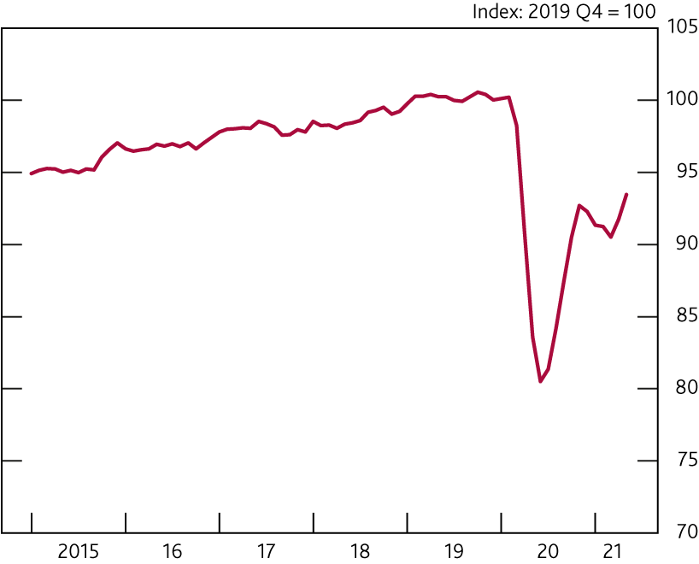
Chart 2.25: Hours worked remain materially lower than pre-Covid levels, primarily reflecting furloughed workers
Total weekly hours
Sources: ONS and Bank calculations.

Slide 29
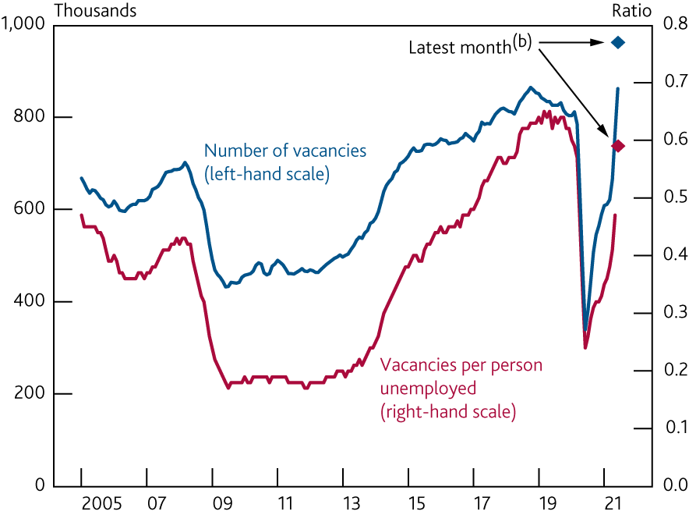
Chart 2.26: The number of vacancies has risen sharply since March…
Vacancies^{(a)}
Sources: ONS and Bank calculations.
(a) Three-month moving averages. Latest vacancy data are for June 2021, latest unemployment data for May 2021.
(b) Diamonds show latest available single-month data. Diamond for vacancies shows single month of June. Vacancies per person unemployed uses June single-month vacancies and the estimate of the number unemployed in the single month of May.

Slide 30
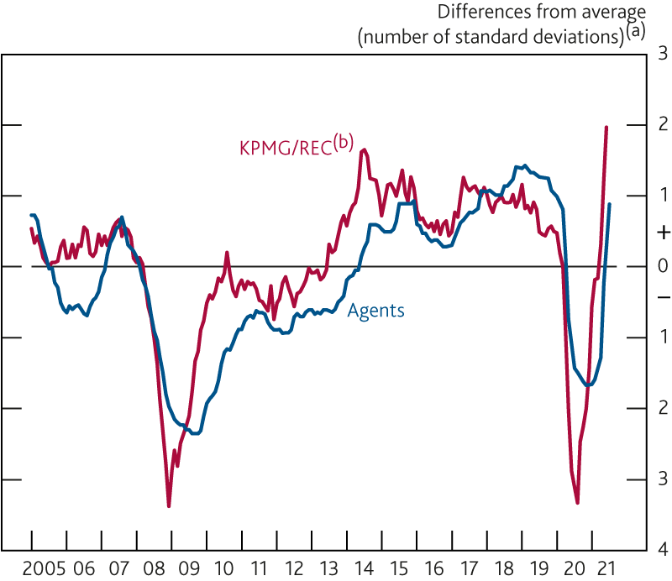
Chart 2.27: …and there have been increasing reports of recruitment difficulties
Indicators of recruitment difficulties
Sources: Bank of England, KPMG/REC UK Report on Jobs and Bank calculations.
(a) Since 2000.
(b) KPMG/REC Availability of Staff Index, inverted.

Slide 31
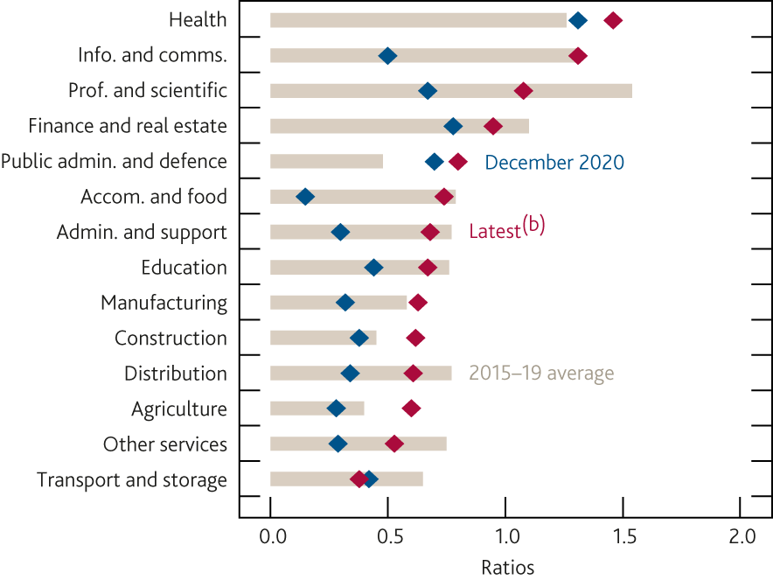
Chart 2.28: The distribution of vacancies and unemployment is wide across sectors
Number of vacancies per person unemployed by industry^{(a)}
Sources: ONS and Bank calculations.
(a) Three-month moving averages. Vacancies in each industry per person unemployed whose last job was in that industry. Unemployment by industry of last job data are not seasonally adjusted.
(b) Latest data point is June for vacancies and May for unemployment.

Slide 32
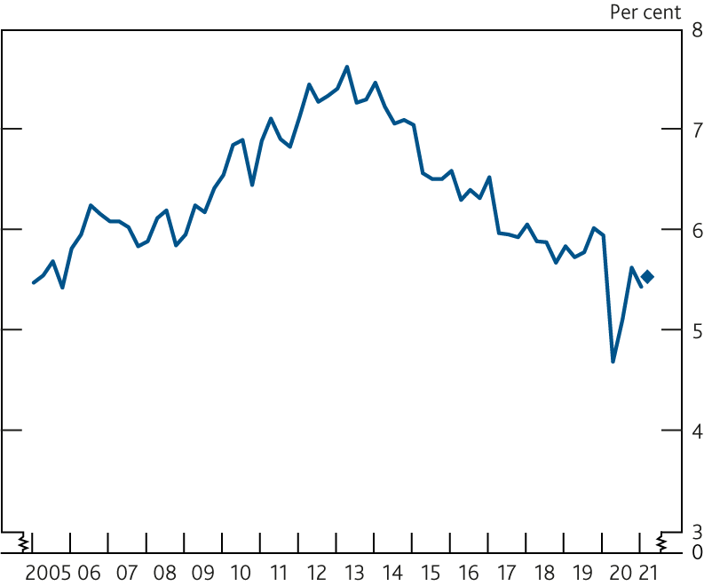
Chart 2.29: Fewer people in work are searching for other jobs
Proportion of people in employment searching for a job^{(a)}
Sources: Labour Force Survey and Bank calculations.
(a) Data are quarterly to 2021 Q1. Diamond shows latest data for the three months to May 2021.

Slide 33
Box C: How strong is pay growth?

Slide 34
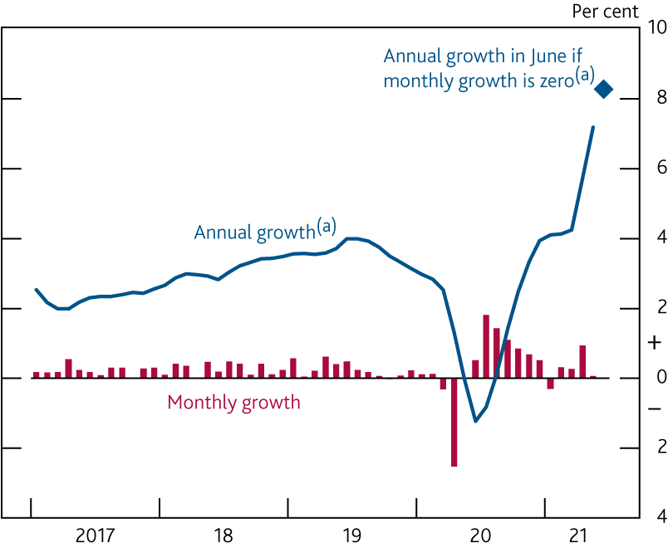
Chart A: Annual pay growth has been strong over the past few months in part due to base effects…
Private sector regular pay
Sources: ONS and Bank calculations.
(a) Growth in three-month average pay relative to the same period a year earlier. Diamond shows annual growth in the three months to June if monthly growth (shown in the red bars) were to be zero in June.

Slide 35
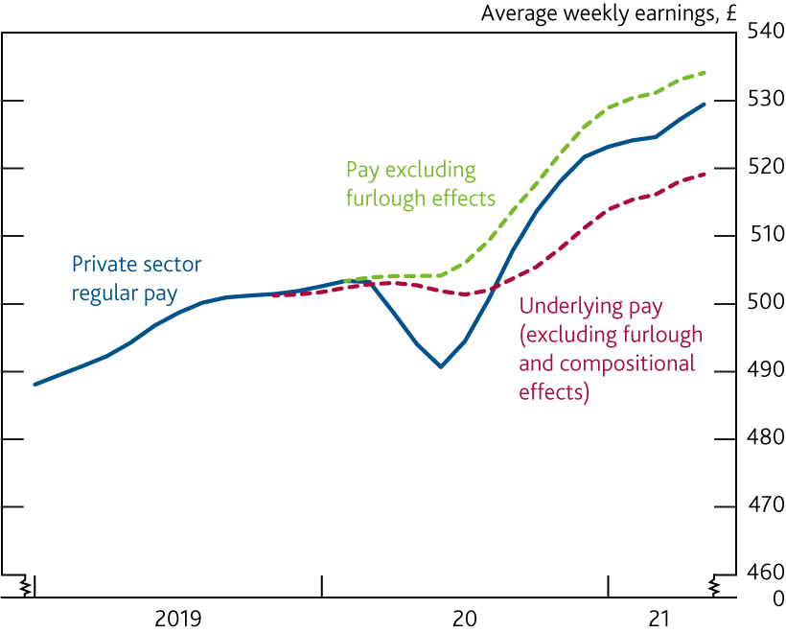
Chart B: …while furlough and compositional effects have been distorting the level of pay
Private sector regular pay and estimated impact of furlough and compositional effects^{(a)}
Sources: HMRC, ONS and Bank calculations.
(a) Three-month moving averages. Furlough and compositional effects are Bank staff estimates. Compositional effects are estimated as an impact on growth rates; the impact on the level of pay shown in this chart is an approximation.

Slide 36
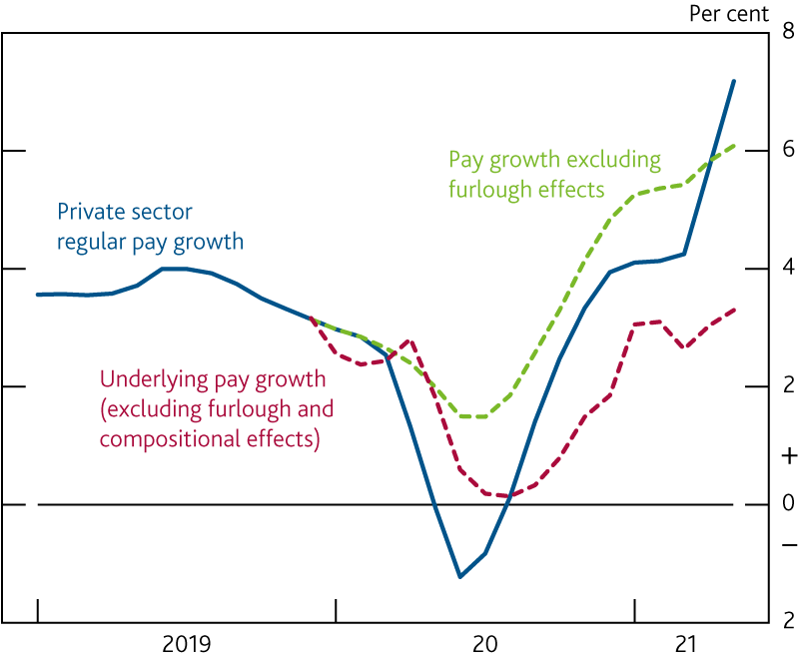
Chart C: Estimated underlying pay growth is around pre-Covid rates
Annual growth in private sector regular pay and estimated impact of furlough and compositional effects^{(a)}
Sources: HMRC, ONS and Bank calculations.
(a) Growth in three-month average pay relative to the same period a year earlier. Furlough and compositional effects are Bank staff estimates.

Slide 37
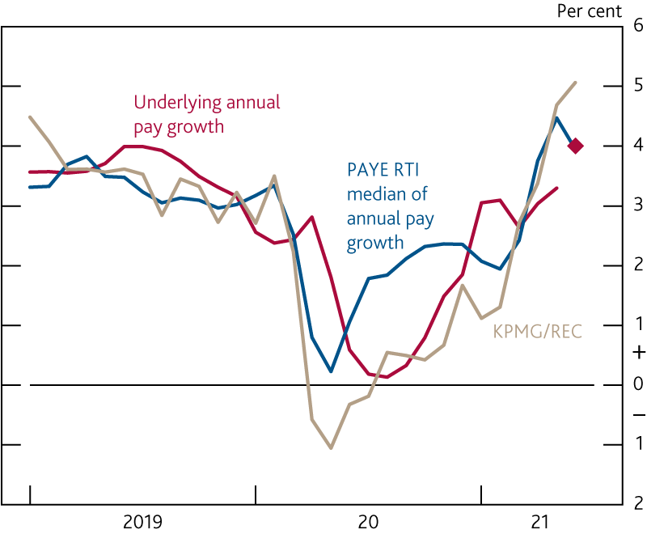
Chart D: Other measures of wage growth give a similar signal to the estimate of underlying pay
Indicators of pay growth^{(a)}
Sources: HMRC, KPMG/REC UK Report on Jobs, ONS and Bank calculations.
(a) Estimated underlying pay growth is growth in three-month average underlying pay relative to the same period a year earlier; data are to May 2021, diamond shows the Bank staff estimate for June 2021. KPMG/REC data are weighted averages, using LFS employee job shares, of diffusion indices of starting salaries for permanent and temporary staff, scaled to match the mean and variance of annual growth in private sector regular pay since March 2001. KPMG/REC and Pay As You Earn (PAYE) Real Time Information (RTI) median of pay growth data are to June 2021.

